Slide 1


SWE and MathWorks Present: Simulink Onramp

Slide 2
Today:
6:15 pm – 6.30 pm: Set-up
Intro
Create MathWorks account
Download Simulink Onramp
6.30 pm – 8.00 pm: Simulink Onramp (on your own)

Slide 3
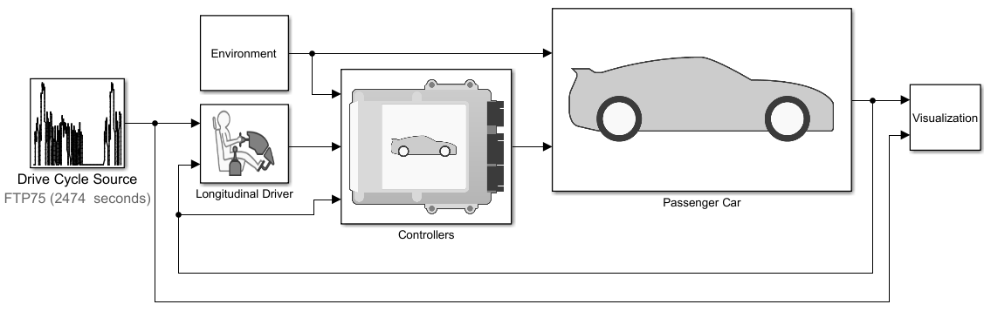

Simulink Overview
Model and simulate your system
Use one multi-domain environment
Model the system under test and the plant
Simulate closed-loop system behavior
Test early and often
Test your system under all conditions
Validate your design with real-time testing
Trace from requirements to design to code
Automatically generate code
Generate production-quality C and HDL code
Deploy directly to embedded processors or FPGA’s/ASIC’s

Slide 4
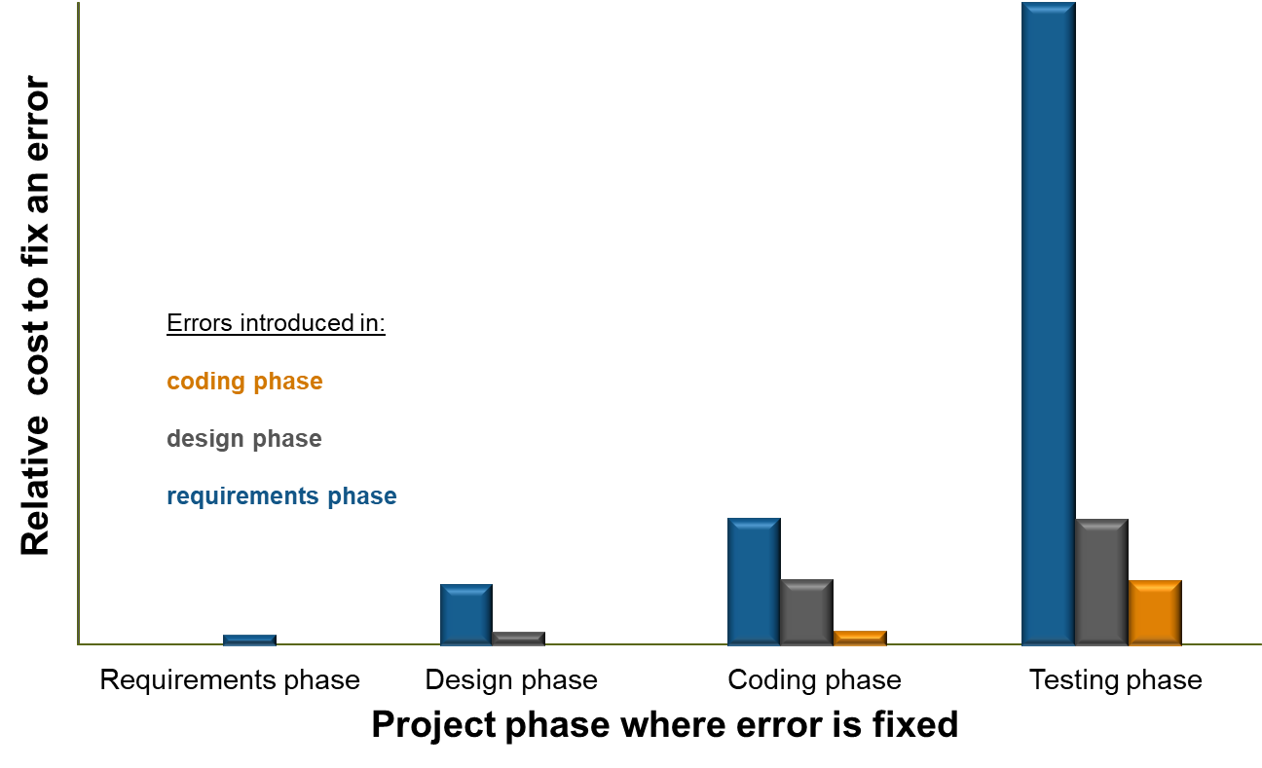
Why use Simulink?
Requirement errors are the most expensive to fix during the testing stages of a project
With Simulink you can reduce the time spent in the testing phase
Visualize, interact with, and test your system all in Simulink to find errors early
Source: Return on Investment for Independent Verification & Validation, NASA, 2004.
Notes:
So why do we need to find errors early, why did people list it as an important challenge?
Here is a study by NASA, that answers these questions. The x-axis shows the phase where the error is found and fixed, and the y-axis shows the relative cost to fix the error.
Bar color corresponds to the project phase where the error was introduced.
So, finding errors early means we can develop our products cheaper and quicker, and that is why it is so important.
[Note to presenter: NASA study can be downloaded directly from http://sarpresults.ivv.nasa.gov/DownloadFile/24/10/Direct%20ROI%20of%20IV&V%20ATS2003%20presentation.ppt
The saved version of the report (powerpoint file) is also available on the ECL).]

Slide 5
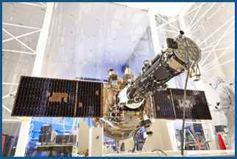
Lockheed Martin Space Systems Develops GN&C System for IRIS Satellite with Model-Based Design
Challenge
Develop the guidance, navigation, and control (GN&C) system for the Interface Region Imaging Spectrograph (IRIS) observatory satellite
Solution
Use Model-Based Design with MATLAB and Simulink to model components of the GN&C system and the IRIS satellite, run closed-loop and processor-in-the-loop simulations, and generate production code
Results
Development efficiency doubled
Efficient, defect-free code generated
Design updates completed in a single day
The IRIS observatory.
“A team of about four engineers designed, integrated, and tested the GN&C system in just 23 months. We were more efficient because we used the same tools for both analysis and code development, and generated 20,000 lines of defect-free code. For us, that makes a compelling case for Model-Based Design.”
- Vincentz Knagenhjelm, Lockheed Martin Space Systems
Link to user story
Notes:
Industries: Aerospace and defense
Application Areas: Embedded systems, Control systems
Capabilities: Algorithm development, System design and simulation, Embedded code generation, Verification, validation, and test
Products Used: MATLAB, Simulink, Embedded Coder, Simulink Coder, Simulink Report Generator, Simulink Verification and Validation, Stateflow
Country: United States
Lockheed Martin Space Systems Develops GN&C System for IRIS Satellite with Model-Based Design
The Interface Region Imaging Spectrograph (IRIS) observatory is currently in Earth orbit, where it is capturing ultraviolet spectra and high-resolution images of the sun. These images will help scientists better understand the flow of energy and plasma in the lowest levels of the solar atmosphere.
Designed and built by Lockheed Martin Space Systems, IRIS has an effective spatial resolution of 0.33 arcsec, enabling it to deliver unprecedented views of the chromosphere and transition region of the sun. To obtain these high-resolution images, IRIS relies on a precise guidance, navigation, and control (GN&C) system that Lockheed Martin Space Systems developed using Model-Based Design with MATLAB® and Simulink®.
“Model-Based Design enabled our small team to meet an aggressive delivery deadline for flight software,” says Bob Dougherty, lead GN&C engineer at Lockheed Martin. “The software has performed flawlessly in orbit, and the project has highlighted our ability to build low-cost, low-risk spacecraft.”
Challenge
On similar projects in the past, Lockheed Martin engineers produced extensive algorithm design documents, some more than 1000 pages long. Programmers wrote the code by hand based on their interpretation of these documents. The entire process was slow, and defects were sometimes introduced during the hand coding.
With just 23 months scheduled for software design, integration, and testing, the team needed to accelerate the software delivery process significantly. To meet this goal, they sought to replace the detailed algorithm design document with a self-documenting design, reuse existing plant models for satellite hardware, replace hand coding with automatic code generation, and use a single environment for analysis and software development.
“A team of about four engineers designed, integrated, and tested the GN&C system in just 23 months. We were more efficient because we used the same tools for both analysis and code development, and generated 20,000 lines of defect-free code. For us, that makes a compelling case for Model-Based Design.”
- Vincentz Knagenhjelm, GN&C engineer, Lockheed Martin Space Systems
Solution
Lockheed Martin engineers accelerated the development of the IRIS GN&C flight software by using Model-Based Design.
Working in MATLAB and Simulink, the engineers developed a basic model of the control system to analyze pointing performance, or how accurately the spacecraft could be reoriented.
To create a plant model, the team reused existing Simulink and Stateflow® models of satellite components developed by the Lockheed Martin Space Vehicle Integration Laboratory (SVIL). They combined models of reaction wheels, magnetic torque rods, a star tracker, sun sensors, and other components with a Simulink model of the environment.
The team exported their Simulink control model, using Simulink Report Generator™ to create an interactive web view that was examined in depth during design reviews.
They verified the initial GN&C design by running closed-loop simulations with the plant model and performing model coverage analysis on the simulations using Simulink Verification and Validation™.
Working with the MathWorks Pilot Engineering Group, they partitioned their initial flight software GN&C model into components, including the attitude controller, reaction wheel controller, and attitude determination module. Each component corresponded to a software unit in the flight code.
They used Embedded Coder® to generate C code for these components, adding a small amount of hand-generated “glue” code for a Moog Broad Reach Engineering radiation-hardened microprocessor and its executive software. Using a custom MATLAB user interface, the team exercised a variety of Simulink test cases for each GN&C flight software unit.
SVIL engineers added an integration layer to the plant model and used Embedded Coder to generate C code, which was deployed to a real-time computer for processor-in-the-loop testing.
After running real-time tests and optimizing the design in Simulink, the team generated approximately 20,000 lines of code for the production RAD750 processor. The GN&C system is in operation aboard IRIS, which is already delivering high-resolution images and spectral data.
Results
■ Development efficiency doubled. “We measured equivalent source lines of code per developer hour and found that Model-Based Design was two to three times more efficient than hand coding for flight software,” says Phil Boyle, GN&C software engineer. “That was true not only for the IRIS project but for other projects on which we used Model-Based Design.”
■ Efficient, defect-free code generated. “We tried to use automatic code generation 10 years ago, but the code had to be heavily reworked before it could be used,” says Boyle. “In contrast, the code we generated for IRIS using Embedded Coder was not only free of defects, it was also efficient.”
■ Design updates completed in a single day. “After IRIS was put into operation, we discovered some peculiarities with the hardware that were unknown before launch,” Boyle says. “To account for this hardware behavior, we simply updated our Simulink models, re-generated code, and reran our unit tests and software item qualification tests. In one day, we were ready with an updated system.”
Learn more about IRIS: www.nasa.gov/mission_pages/iris/

Slide 6
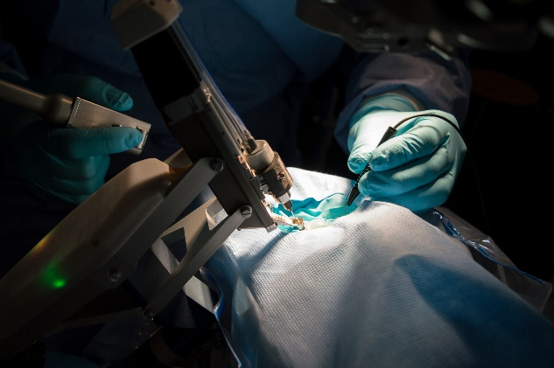
Preceyes Accelerates Development of World’s First Eye-Surgery Robot Using Model-Based Design
Challenge
Develop a real-time control system for robot-assisted surgical procedures performed within the human eye
Solution
Use Model-Based Design with MATLAB and Simulink to model and simulate the control system and use Simulink Coder and Simulink Real-Time to deploy it to a real-time target
Results
Core controller developed by one engineer
Patient safety assured
Road map to industrialization set
The PRECEYES Surgical System. Image copyright and courtesy Preceyes.
“MATLAB and Simulink provided a single platform that supported our complete workflow and all the components and protocols we needed for our robotic system. That enabled us to quickly develop a safe, real-time device, ready for clinical investigation.” - Maarten Beelen, Preceyes
Link to user story
Notes:
Industries: Medical devices
Application Areas: Embedded systems, Control systems, Mechatronics, Robotics
Capabilities: Mathematical modeling, Algorithm development, Data analysis, System design and simulation, Rapid prototyping
Products Used: MATLAB, Simulink, Simulink Coder, Simulink Real-Time, Stateflow
Country: The Netherlands
Preceyes Accelerates Development of World’s First Eye-Surgery Robot Using Model-Based Design
Vitreoretinal surgeries, which are performed inside the eye, require a degree of precision and stability that is extremely difficult for the human hand to sustain. A big increase in vitreoretinal diseases, strongly correlated to the aging population, demands the development of new treatments that require even higher levels of precision. A potential new treatment for retinal vein occlusions, for example, would involve inserting a needle into a vein as thin as a human hair and holding it still for about 10 minutes—a task that would be virtually impossible for even the most skilled surgeons.
Surgeons at the John Radcliffe Hospital in Oxford, England, performed the world’s first robot-assisted vitreoretinal surgery in 2016. They used the PRECEYES Surgical System, a robotic assistant that scales the surgeon’s movements and filters hand tremors to enable unprecedented steadiness and precision.
More recently, Preceyes started clinical trials at Rotterdam Eye Hospital. They successfully integrated their newly developed distance sensor in the robot and validated the robot-sensor combination. The sensor measures the distance of an instrument from the retina inside the eye. Providing sensor-based safety and guidance, this approach promises to provide significant safety and performance benefits during demanding retinal surgery. Moreover, it will be a valuable source of data for training and evaluation. Engineers at Preceyes designed and implemented the robot’s control system using Model-Based Design with MATLAB®, Simulink®, and Simulink Real-Time™.
“As a lean startup, it was important for us to achieve a first release quickly without compromising safety, in order to obtain clinical feedback and to build evidence, before designing a final product,” says Maarten Beelen, cofounder and integration manager at Preceyes. “Simulink and Simulink Real-Time enabled us to rapidly design our controller, verify it, implement it on a real-time system, and test it with users. A traditional software development workflow would probably have extended our timeline considerably.”
Challenge
Preceyes set ambitious objectives for its surgical system. Not only would the enhanced precision make new procedures possible, it would also improve existing procedures, such as the peeling of membranes from the retina and the replacement of the eye’s fluid. In working toward these objectives, the Preceyes team had two priorities: to ensure patient safety and to produce a working clinical investigation device as efficiently as possible.
To achieve their design objectives within the development schedule and safety constraints, Preceyes engineers needed to take advantage of modeling and simulation technology that had been used in other safety-critical applications across multiple industries. Specifically, they needed to model complex control logic and then perform functional verification of their design, first via simulation and then via real-time tests on the actual robot. In addition to real-time control software, the team needed to develop a non-real-time application with an interface running on a PC that physicians could use to configure settings before and during surgical procedures.
“MATLAB and Simulink provided a single platform that supported our complete workflow and all the components and protocols we needed for our robotic system. That enabled us to quickly develop a safe, real-time device, ready for clinical investigation.”
- Maarten Beelen, Preceyes
Solution
Preceyes used Model-Based Design with MATLAB, Simulink, and Simulink Real-Time to accelerate the development of a real-time control system for its PRECEYES Surgical System.
While constructing a basic model of the robot’s kinematics and dynamics, Preceyes engineers conducted system identification tests in which they used Simulink Real-Time to produce excitation signals for the robot’s 11 electromotors and then measured the responses across each of its 11 degrees of freedom.
After analyzing and fitting the measurement data in MATLAB, they used the results to develop a Simulink plant model that described how the robot moved in response to applied forces.
The team developed a controller model that processes input from the system’s joystick and approximately 60 sensors—including optical and magnetic encoders—and generates the necessary motor signals to move the tool tip in response to the surgeon’s movements. Within this model, they incorporated EtherCAT blocks from Simulink Real-Time to interface with nodes on the robot’s EtherCAT network.
Using Stateflow®, the team modeled sequential logic for the system’s various operating modes, which include calibration, initialization, and self-verification.
After verifying the basic operation of the controller and control logic through simulation, the engineers generated code from their model using Simulink Coder™ and deployed the compiled code to a real-time target computer running Simulink Real-Time. This computer was connected to the robot’s sensors and motors via the EtherCAT network.
To refine and enhance the controller, the team made improvements to the model, checked them via simulation, and then tested them on the actual robot using the Simulink Real-Time setup.
The engineers used GUIDE, a MATLAB UI development tool, to develop the touch-screen application software that surgeons use to change surgical settings and receive visual and acoustic feedback during surgery.
The safety and efficacy of the PRECEYES Surgical System has been demonstrated in 14 surgical procedures. Additional demonstrations are planned at top surgical sites, including a two-year collaboration with Rotterdam Eye Hospital. The company is also working on CE registration and the next generation for volume production.
Results
■ Core controller developed by one engineer. “With MATLAB and Simulink, I did not have to program a low-level architecture for the controller by myself. As the sole software engineer developing the first release, that was a huge advantage—in fact, I doubt if a single engineer could have done the work otherwise,” says Beelen. “The software was extensively reviewed by consultants, which was quite easy because of the readability, requirement traceability, and report generation capabilities in Simulink products.”
■ Patient safety assured. “I always said I would not bring a device to market unless I was fully confident using it on myself or on a loved one,” notes Beelen. “With the safety mechanisms we had implemented in Simulink, I was 100% comfortable that there would be no problems with the software.”
■ Road map to industrialization set. “For the development of the industrialized release of our system, we will save time by generating code from our existing controller model, using Embedded Coder to target an embedded processor,” says Beelen. “We will follow a more formal development and testing workflow, with improved revision control and a larger development team, using model-based testing, verification, and validation capabilities in Simulink.”
Learn more about Preceyes: www.preceyes.nl

Slide 7
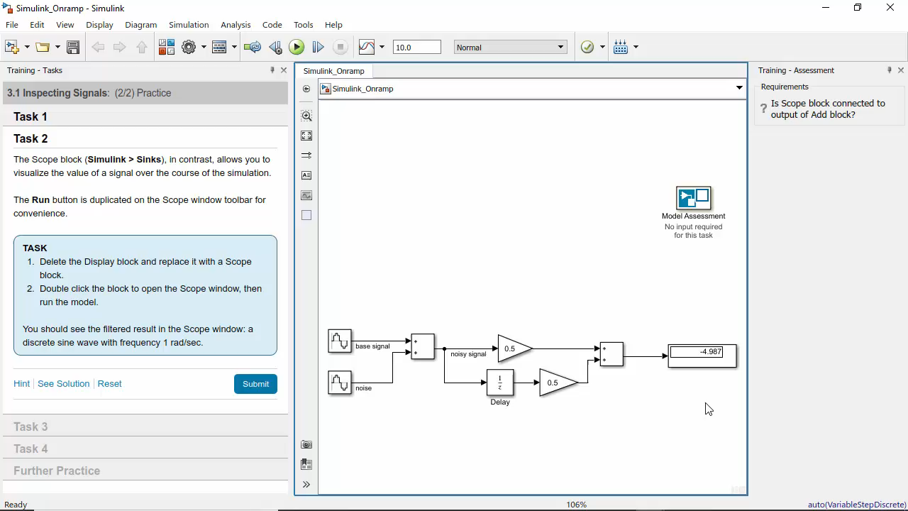
Simulink Onramp
Get started quickly with the basics of Simulink with this self-paced, interactive tutorial
Includes video tutorials and hands-on exercises with automated assessments and feedback
How to get started:
Download the latest release of Simulink
Download and install Simulink Onramp from the MATLAB File Exchange
Launch MATLAB and open Simulink
Select Simulink Onramp from the Start Page

Slide 8
Opening Simulink Onramp
From MATLAB open Simulink
In the lower left-hand section under “Learn” select “Simulink Onramp”
Click “Course Overview” to get started

Slide 9
Prizes
Complete at least 60% of Simulink Onramp to be eligible for any prize
Bring your laptop when you come to collect the prize
Follow Us on Facebook!
Find us on Facebook at [Insert Facebook Group Name]

